Slide 1
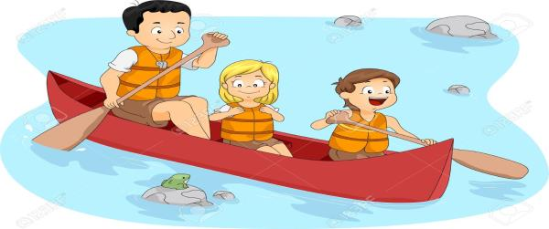
Have Fun…..But Be Safe
A Guide to Safe Paddle Craft:
canoes, kayaks, and SUPs
Copyright 2018 - Coast Guard Auxiliary Association, Inc.
Notes:
This presentation is designed to be flexible in the age range targeted audience and Instructors are expected to tailor the presentation to the age appropriateness of students. Use of the Instructor Activities document that accompanies this presentation will help the Instructor build a lesson plan that includes activities to reinforce this presentation. The goal of inclusion of activities is to reinforce the learning objectives presented in this module.

Slide 2
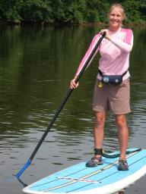
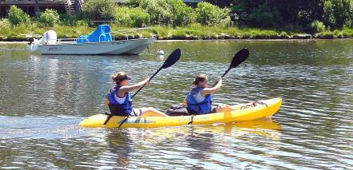
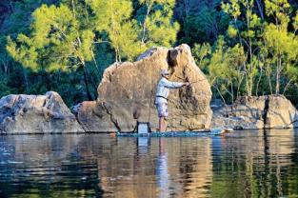
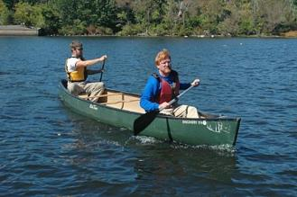
There are Many Kinds of Paddle Craft
Notes:
Can you tell what these people are doing in a paddle craft? What kinds of paddle craft and activities can you see? Kayaks? Canoes? Stand-Up-Boards? Fishing?

Slide 3
No Matter What Kind of Boat….
Always Remember: Safety First
Wear Life Jackets
Wear a Whistle
Plan Your Trip
Notes:
Three primary messages students should retain after the class is over. Details follow. Note that the paddler might not wear the whistle – it probably belongs securely attached to the PFD. Proper attachment is a big concern in whitewater – some paddlers tie their whistle on with a loop, creating an entanglement hazard. Encourage storing it in a pocket, or on a very short break away link.

Slide 4
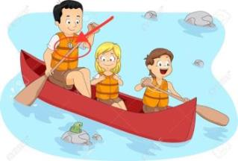
Life Jackets/Whistles
USCG-approved Life Jacket
Should be worn at all times
Wear is required for ages under 13 (check your state law)
May be inflatable age 16 and up
“Sound device”—wear a whistle—attached to the Life Jacket (see picture above)
Notes:
**Instructors Can Adapt These Comments to Fit the Age-Appropriateness of Their Students.**
The lifejackets
U.S. Coast Guard approved life jackets are required for every person in the boat, and should be worn by everyone whenever they paddle. This includes your parents, brothers and sisters, friends. Encourage wear within 10 feet of the water’s edge to help reduce the risk of falling in unexpectedly; rarely an issue on lakes, but actually the standard of care for whitewater
* Lifejackets need to be fitted and adjusted appropriately for adults and children. Children under 13 years of age MUST wear a life jacket.
* Children’s life jackets are approved for specific weight categories Check the “User Weight” on the label and for an approval statement
* U S Coast Guard-approved inflatable life jackets are authorized for use by persons 16 years of age and older (check the label)
* Inflatable life jackets require regular maintenance and attention to the condition of the inflator
* Inflatable lifejackets should only be orally or manually inflatable—not “automatic” on paddle craft. Unfortunately, this means that inflatables provide no protection from cold shock if a person unexpectedly enters cold water. Further, inflatables have to be repacked after deployment, or the paddler has to keep them inflated the rest of the trip. Therefore, inflatables are only appropriate in the mildest conditions where a paddler is unlikely to need them.
* Bright colors such as red, yellow, or orange enhance visibility and are preferred over blue, olive, or camouflage on waterways. While generally true, depending on the environment, other colors might be good. For example, black shows up extremely well in muddy (river) water.
* Capsizes and falls overboard are common among paddlers – wearing a lifejacket dramatically reduces the risk of injury or death during such an event.
Lifejackets not only reduce the risk of drowning, they also can provide protection from rocks and other debris in rivers, provide a place to store critical emergency equipment (e.g., whistle, signal mirror, light), and can help keep paddlers warm. Always remember that a whistle Is not a toy. It is for getting help or attracting attention when you can’t be seem by bigger vessels. Although you could have an air horn to meet carriage requirements, it might be worth emphasizing that the whistle is on you all the time, ready to be used in the rare cases it’s needed.

Slide 5
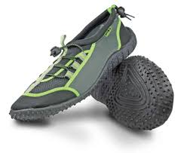
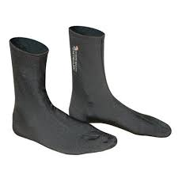
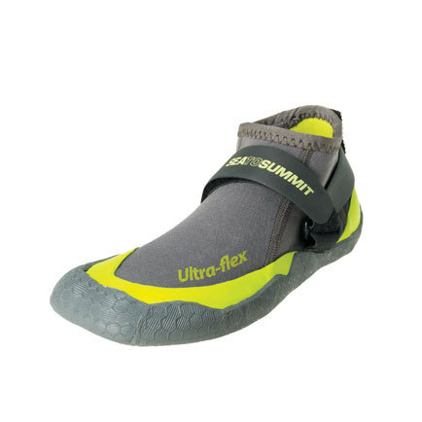
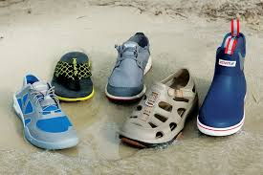
Consider Footwear
Although Not Required, Consider Wearing Appropriate Footwear:
Helps to prevent your heel blistering from friction against the hull while paddling.
If you need to walk, your feet will be protected from rough or sharp terrain.
Notes:
Proper footwear can protect your feet from blisters and cuts, which could turn a nice day into a painful day. Much like sunscreen makes for a more pleasant experience in the sun, proper footwear will help make for a more fun day on your paddle craft. They can help prevent blisters from the friction of your heel moving against the hull of your boat. If you have to walk, proper footwear will protect your feet from sharp rocks, thorns, rough terrain, and other objects that might cut or bruise your feet turning a fun day into a painful one.

Slide 6
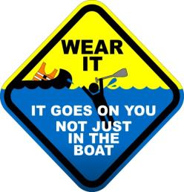
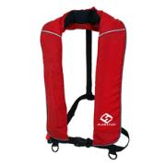
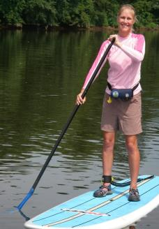
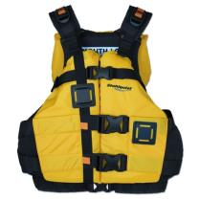
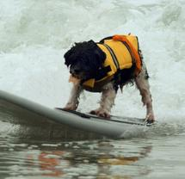
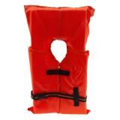
Types of Life Jackets
Notes:
There are many different kinds of life jackets you can get. Some go around your body, some are inflatable, some go around your waist. Adults can wear the inflatable or waist belts. Children should always wear specific life jacket made to fit children. Don’t forget one for your dog! Consider noting that PFDs are like seat belts. Putting it on after the accident doesn’t help.

Slide 7
Coast Guard Approval Tag
Always Look for This Tag and the printed label inside to know your Life Jacket is Coast Guard Approved

Slide 8
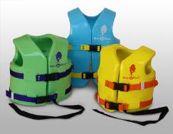
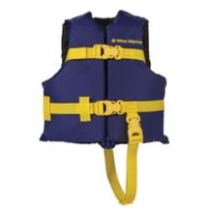
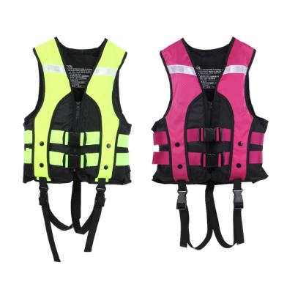
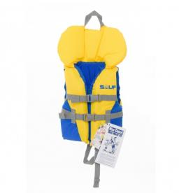
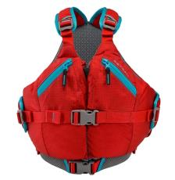
Life Jackets for Kids
Notes:
Life Jackets come in different sizes. Always be sure it fits and won’t fall off. If possible, demonstrate different sizes and types. With parent’s permission, have kids try the wrong size on and demonstrate why fit is important.

Slide 9
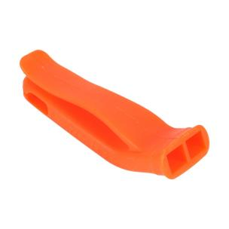
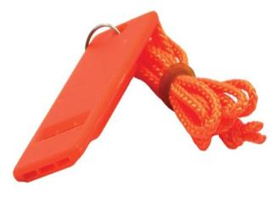
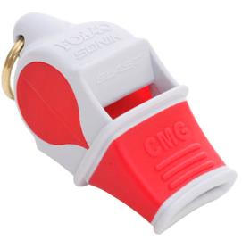
Whistles
Attach a whistle to your life jacket.
3 long whistle blows alert others to danger.
Decide among your group which signal to use.
Notes:
Coastal Emergency signal is 5 short whistle blows. Among paddlers, 3 long blows alerts others to danger. Have the group agree on signals to be used before departure.
Best to use a whistle made for use in the water…..without the “pea.”
Emphasize that the 3 blasts should be repeated. Tell students that if someone is repeatedly blowing a whistle at you, whether it’s 3, 5, 9 or some other number of blasts, you should probably go check on them.

Slide 10
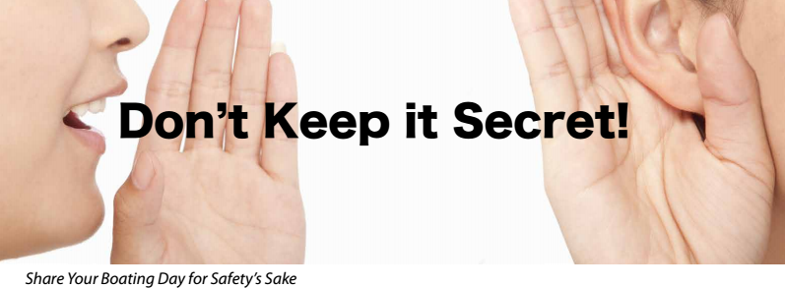
Trip Planning
Notes:
Planning your trip
Always tell someone where you are going– don’t go farther than you should. It is important that your family always lets a friend or neighbor know where you are going, and when you expect to be home.

Slide 11
Trip Planning
Don’t go farther than you should – stay in shouting distance of shore and others with you.
Check the weather before you go.
Leave a note with a friend listing where you are going, the time you are leaving, and the time you expect to be back. This is called a “Float Plan.”
Kids under age 10 should paddle with adult supervision.
Don’t go alone. Always go with 2 or 3 others.
Always wear your life jacket, wear a whistle and consider a flashlight in case of bad weather.
Notes:
Never go farther than you should.
Check for weather and water conditions
* Learn about local hazards
* Learn about access points
* Have a back up plan
* Develop and file an appropriate float plan for your trip, describing your route and access points, length of trip, number of people and boats on the trip, when you would be overdue, and what to do if you are overdue.
Equipment
* Make sure you have appropriate equipment for your type of boat and the area you plan to paddle
* Make sure your equipment is in good working order before you head out
* Stow the equipment properly; plan for a capsize
* Make sure you have appropriate charts, maps and directions
Group
* Paddling with a group is safer (3 people / two boat minimum)
* Ensure each group member has appropriate knowledge, skills and equipment for the trip
Instructors Should Adapt These Comments to Fit the Age-Appropriateness of Their Students.
We cannot over emphasize the importance of paddling in a group. If an accident happens, groups of one person are a tragedy; groups of two provide a witness; groups of three or four or more have a chance at a rescue.

Slide 12
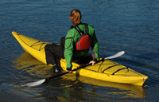
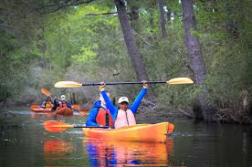
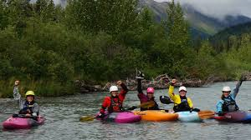
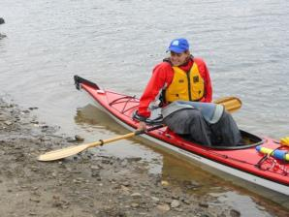
On the Water
Notes:
***Instructors Should Adapt These Comments to Fit the Age-Appropriateness of Their Students***
On the water
Boarding, exiting and moving about the boat
* Put on your life jacket before boarding, and keep it on all the time during the paddling trip
* When boarding or exiting a boat, keep weight low, and move slowly to reduce the risk of capsize
* Maintain at least 3 points of contact when boarding, exiting, or moving about the boat
* Avoid switching positions once away from shore. If you do move, use good principles (such as moving one person at a time, moving slowly, moving along the centerline and maintaining a low center of gravity).
* Avoid sudden movements in the boat
Paddling
Paddling in groups of three or more is generally safer
* Boat politely – look out for yourself and everyone else on the water
* Boat conservatively – stay within your skill level
* Hands-on instruction makes paddling safer and more fun
Other activities
* Pets should use properly fitted lifejackets
* Anticipate sudden movements from animals in boats

Slide 13
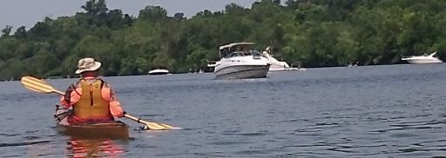
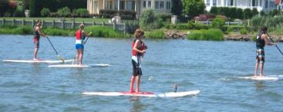
Be Aware Out There
Look out for other boats such as powerboats and commercial boats
Learn the “Rules of the Road” and use them!
Notes:
***Instructors Should Adapt These Comments to Fit the Age-Appropriateness of Their Students.***
*Situational awareness is necessary for safety
*Human powered craft are especially vulnerable because they are hard to spot and can be run over by powered vessels, both recreational and commercial. Paddle craft are slow, small and hard to see; if power boaters can’t see you, they won’t try to avoid you, so your best approach is to stay away from areas with lots of power boats. Stay out of channels, stay closer to shores, and paddle in a group so you’re easier to see.
*The Navigation Rules provide a structured way to learn the relationship between various types of boats and ships.
*If paddling on navigable waters be especially aware of other boats and of your, the paddler’s, responsibilities to keep clear.

Slide 14
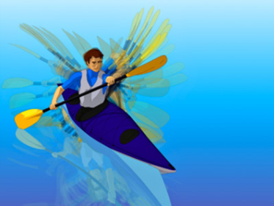
Be Sure People Can See You
Paddle Flash: Sunlight off the paddle helps others see you.
Motion: Paddle movement
Clothing: Bright clothes
Life jackets in bright
colors help people
see you
Notes:
***Instructors Should Adapt These Comments to Fit the Age-Appropriateness of Their Students.**
Visibility
* Maximize your visibility through color and contrast
* Bright clothes, lifejackets and boats are easier to see
* Carry a bright white light if there is any chance you may paddle at night
* consider carrying bright or reflective flags to increase visibility
Your paddle will glint—that will be the first thing an oncoming boat is likely to see. Second is the motion of the paddle. The paddler is third.
Paddle in a group; groups are much easier to see. Consider a brightly colored paddle blade. Yellow or bright green seem to work best

Slide 15
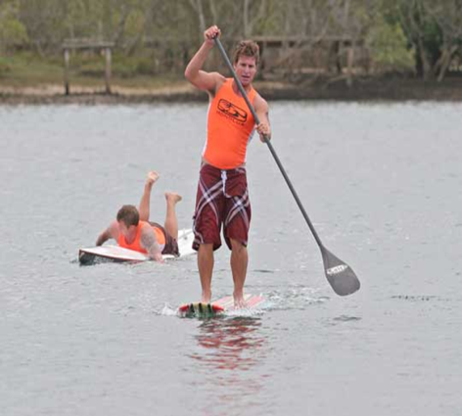
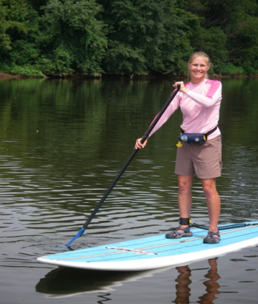
Stand Up Paddlecraft (SUP)
What’s Wrong with This Picture?
What’s Right with This Picture?
Notes:
***Instructors Should Adapt These Comments to Fit the Age-Appropriateness of Their Students.***
SUPs
Stand Up Paddleboards-SUPs-are legally considered boats.
The paddler on the left is using a board too small. He has no (required) life jacket. Despite the rocky shore, he has no suitable footwear.
The woman on the right side has the right size board, is properly wearing an inflatable life jacket, has on suitable footwear, and has a leash that attaches her to the board by way of her right ankle. Ankle leashes are useful, but not for surf, swift currents (white water) or conditions where being tied to the board could prove dangerous—situational decision making applies.

Slide 16
Top Safety Tips for SUPs
1. Wear a lifejacket and wear a whistle
2. Know how to swim
3. Know the local regulations and rules
4. Know your weather and area – winds, water,
terrain
5. Know when to wear a leash
6. Don’t go where you aren’t supposed to be and
avoid other swimmers, boaters, paddleboards
7. Take a safety course
Notes:
***Instructors Should Adapt These Comments to Fit the Age-Appropriateness of Their Students.***
Top Ten Safety Tips for SUPs (These are more detailed than on the slide: adapt for ages of students.
1. Wear a lifejacket and carry a whistle
2. Be a competent swimmer
3. Know how to self rescue
4. Know how to tow another board
5. Know the local regulations and navigation rules
6. Understand the elements and hazards – winds, tidal ranges, current, terrain
7. Know when to wear a leash
8. Be defensive – don’t go where you aren’t supposed to be and avoid other swimmers, boaters, paddleboards
9. Use proper blade angle to be the most efficient paddle boarder
10. Take a safety course - See more at: http://coastguard.dodlive.mil/2012/05/top-10-tips-for-stand-up-paddleboarding/#sthash.YuqM93S4.dpuf

Slide 17
Top Paddle Craft Safety Tips
1. Take a Safety Course
2. Wear Your Lifejacket and Whistle
3. Consider Cold Water Safety
4. Know Rules of the Road
5. Get a Safety Check
6. Practice Good Ethics and Conduct
7. Know Your Limits
8. Perform Trip Preparation and Planning
9. Consider Appropriate Footwear
10. Learn Rescue Skills
Notes:
***Instructors Should Adapt These Comments to Fit the Age-Appropriateness of Their Students.***
There are more tips here than on the slide. Adapt as needed for age appropriateness of children.
1. Take an On-Water Skills Course - whether it's a safety or skill development course, an instructor-led on-water instruction course provides the information you need for canoeing, kayaking, stand up paddleboarding, rafting or safety & rescue.
2. Wear Your Lifejacket - Expect to capsize and swim occasionally when paddling a canoe, kayak, SUP or raft? Learn more about PFDs and how they might just save your life.
3. Consider Cold Water Safety - Cold water is extremely dangerous! Learn the essentials of on-the-water temperatures and first aid. Learn more about protecting yourself in this environment
4. Know Rules of the Road - What paddlers need to know when sharing the waterways
5. Get a Safety Check - Safety tips you need to consider the next time you head out on the water
6. Practice Good Ethics and Conduct - Key points on how to appropriately share, and enjoy our natural paddling resources: https://c.ymcdn.com/sites/aca.site-ym.com/resource/resmgr/sei-educational_resources/brochure_practices-ethics-co.pdf
7. Know Your Limits - Good things to contemplate before you leave shore
8. Trip Preparation and Planning - Getting ready to schedule your next trip? File a Float Plan. Learn and Practice Best Practices for Paddlers and Paddlesports Programs: https://c.ymcdn.com/sites/aca.site-ym.com/resource/resmgr/sei-educational_resources/brochure_best_practices.pdf.
9. Consider Appropriate Footwear to protect you feet from blisters and sharp objects.
10. Learn and Practice Essential Rescue Skills such as how to right a capsized paddle craft and how to re-enter from in the water.

Slide 18
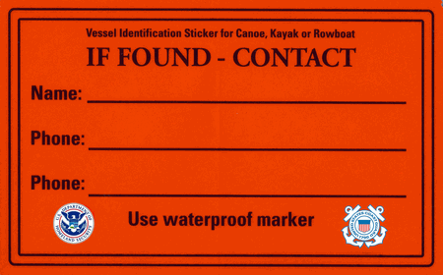
Put your name and your home telephone number on your boat!
John Doe
Home phone
Another phone-spouse cell
If you had your cell phone in the kayak, it won’t work wet unless in a waterproof case!
Notes:
You need to put your name and a contact phone number on your boat in case it blows or floats away—or in case you are overboard. Use an indelible marker, a paint stick, or nail polish so it doesn’t wash away. Place the sticker in a prominent location. Inside the gunnel on the starboard side is a good location. They may fade if they are put on the deck.
With this information, first responders will call and determine you are safe or they need to search for you.
If you can’t get a printed form, use a piece of duct tape and an waterproof marker. Anything is better than nothing.
Have your parents consider putting owner information in an obvious place e.g., the cockpit, under the thigh for emergencies, and also in a difficult to reach and non-obvious location (so if your boat is stolen, you can prove it’s yours.

Slide 19
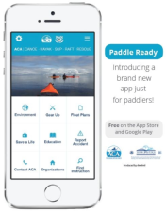
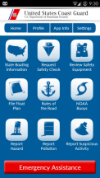
Tell Your Family About “Smart” Resources
These Apps are available for free in iOS or Android format from your Apps Store:
ACA’s Paddle Ready Coast Guard Boat Safety
Notes:
***Instructors Should Adapt These Comments to Fit the Age-Appropriateness of Their Students.***
Both of these apps are available for either Android or iOS at the App Store. Adapt as appropriate for student ages.
The ACA app “Paddle Ready” app includes the following functions (version 1.0):
* Environment
* Gear
* Float Plans
“Save a Life” – detailed information about life jackets and other safety gear
* Education—
Signs and Signals
How to Rescue
* Accident Report Form
* ACA contact—phone, email, or snail mail
* Organizations—Paddling clubs and groups by state
* Instruction finder—Zip Code sort to locate an instructor for your specific paddling discipline and geographic area
U.S. Coast Guard Safe Boating app includes the following functions:
* Emergency Assistance direct contact capability (requires registration)
* State Boating Information
* Safety Check Request (yes, paddle craft can have a vessel safety check)
* Safety Equipment review (generic)
* Float Plan (form)
* Rules of the Road
* NOAA buoys – these give current conditions of wind and water. Temperatures. Directions.
* Hazard Report procedure
* Pollution Report procedure
* Suspicious activity report

Slide 20
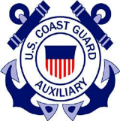
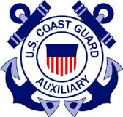
In Summary
Tell Your Parents, Family, and Friends
Always Wear Your Life Jackets
Wear a Whistle (made for the water)
Tell People Where You are Going
Wear Brightly Colored Clothes
Paddle in a Group
Get On-the-Water Instruction
Have Fun…..But Be Safe
Copyright 2018 - Coast Guard Auxiliary Association, Inc.

